Slide 1

An Investigation into a Smart Healthcare Monitoring System in an IoT Environment
FINAL YEAR PROJECT 1(ECB 4252)
FINAL PRESENTATION
Salini Pradhan 1102181006

Slide 2
CONTENTS
ABSTRACT
PROBLEM STATEMENT
SCOPE OF STUDY
RESEARCH QUESTIONS
HYPOTHESIS
LITERATURE REVIEW
METHODOLOGY
PRELIMINARY RESULT
DISCUSSION
GAANT CHART
CONLUSION

Slide 3
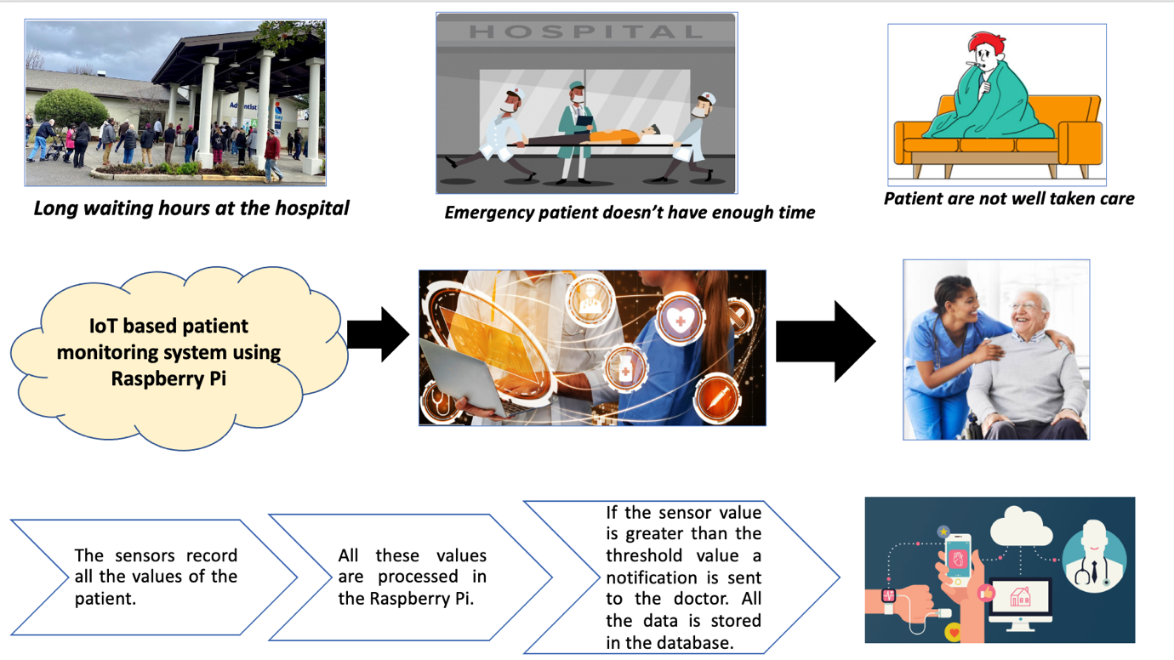
ABSTRACT

Slide 4
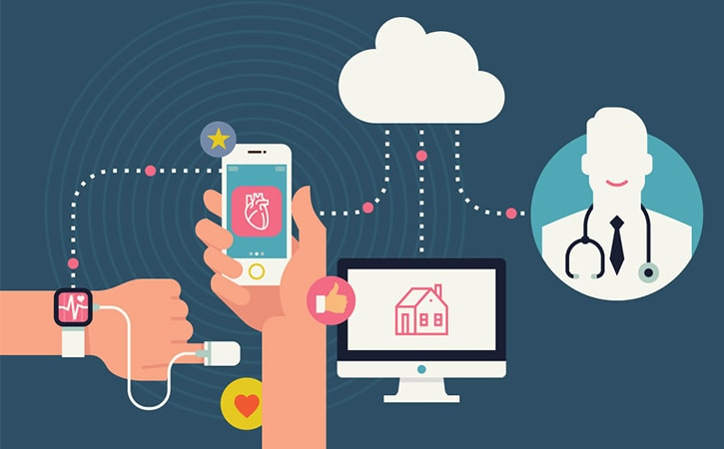
OBJECTIVES
To implement an IoT based patient monitoring device that monitors the temperature of the body, pulse rate, and blood pressure.
To measure the patient's pulse rate, temperature and blood pressure using Raspberry Pi.
To store patients reading of the sensors in the cloud database using Raspberry Pi.

Slide 5
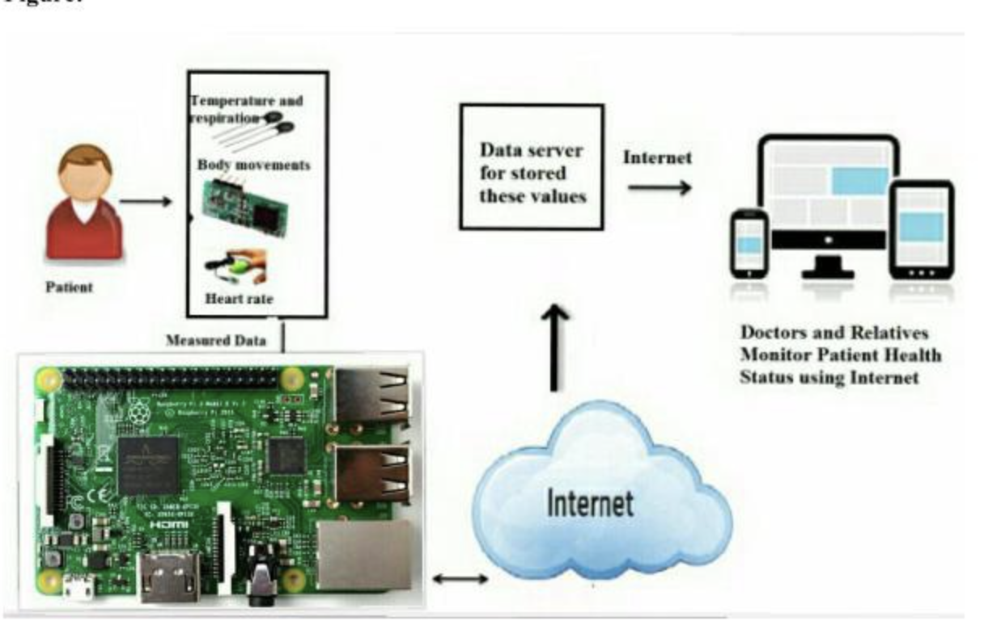
PROBLEM STATEMENTS
When a patient visits a doctor there is always a long waiting line even in the emergency room to get checked.
If security is not provided to go through the data by the doctor; anyone can prescribe any sort of medicine to the patient.

Slide 6
SCOPE OF STUDY
IoT based patient’s smart healthcare device, helps enhance the health of the patient by staying at home. Blood pressure, temperature, pulse rate and ECG are the sensors used. The sensor is then linked with the Raspberry Pi Model B+
The Raspberry Pi connects the reading of the patient with the database. This proposed system is detailed with its methodology and key components listed; along with its block diagram, circuit diagram and cloud computing.
The flowchart of the research activity along with the project is elaborated. Then, the preliminary data is added with the budget of this project fully described. This project is then concluded with a Gantt chart for FYP 1 and FYP2.

Slide 7
RESEARCH QUESTIONS
Explain requirements in getting an accurate reading.
Evaluate the possible challenges and limitations observed during the use of different kinds of sensor like heart sound, pulse rate and blood pressure.
Compute the message to the doctor get sent in the exact time.
Calculate the possible ways to have accuracy with the different measurement.
Explain if sensor collects the data and sends it to the cloud database.

Slide 8
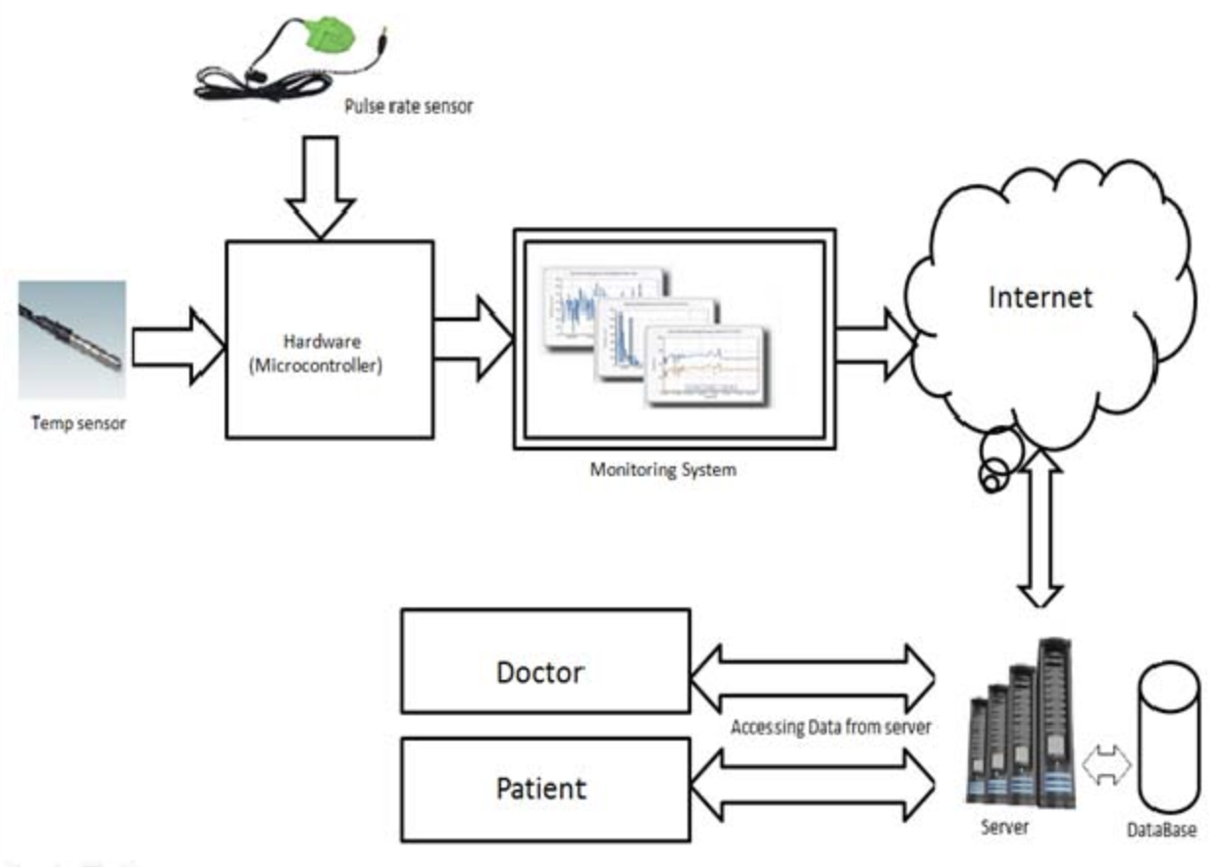
HYPOTHESIS
More parameters can be sensed and tracked as sensors become available or as biomedical trends evolve, improving the ability of the wireless detecting devices in biomedical field.
This device can be portable and easy to use. There can be additions of different sensor like ECG sensor, spo2 sensor, accelerometer sensor.

Slide 9
LITERATURE REVIEW
S. No. | Author(s) & Year | Title of Research Paper | Variables Studied/ Research Design | Equipment/ Instruments/ Apparatus used for Experiments/Analysis/ Characterization, etc. | Important Findings | Limitations of Study | Research Gap/ Novelty of Research Study
1. | (Naik & Sudarshan, 2019) | Smart Healthcare Monitoring System Using Raspberry Pi on Iot Platform | patient's body temperature, ECG, heart rate parameter, blood pressure, Electrical activity of the heart, Rate of movement | temperature sensor, BP sensor, heart rate sensor, an ECG sensor, acceleration sensor, raspberry Pi with GSM | A doctor can review a patient's medical history and recommend medicine and prescription adjustments. Patients with special IDs and passwords have access to their records. | Data transmission is contingent on the presence of a smartphone. | Build up a website for the data transmission.
2. | (Gupta et al., 2015) | Healthcare based on IoT using Raspberry Pi | Electrical activity of the heart, Heart beat rate | ECG sensor Raspberry Pi Module, GSM Module, Buzzer | If the heart rate is out of the usual range, send an SMS to the designated person via the GSM module, and notify the hospital via a buzzer sound. | Only a few parameters are being tracked. | More parameter can be added such as temperature sensor, blood pressure sensor etc.

Slide 10
3. | (Rohit & Tank, 2018) | Iot Based Health Monitoring System Using Raspberry PI - Review | Electrical activity of the heart, Heart beat rate, Temperature, blood pressure, Position of the patient | Pulse/Heart beat sensor, ECG sensor, Body temperature sensor, Blood pressure sensor, Patient position sensor, Raspberry Pi | This entire health monitoring system fits into a small compact gadget the size of a cell phone or wrist watch. | Monitoring isn't personalized for each patient. | The monitoring can be personalized to each patient.
4. | (Amru et al., 2020) | IoT-based Health Monitoring System with Medicine Remainder using Raspberry Pi | Heart beat rate, Body Temperature, | Heart beat sensor, temperature sensor, raspberry pi, RTC (DS1307), a buzzer and LCD monitor, APR9600, speaker and IR receptor | In regard to genius urban inhabitants, the key components of urban shrewd regions are coordinated with knowledgeable home human services, such as high-prescription, clever homeland, intelligent living, and safety. | Only a few parameters are being tracked. | More parameter can be added.
5. | (Pardeshi et al., 2017) | Health monitoring systems using IoT and Raspberry Pi—A review | Heart beat rate, Body Temperature, blood pressure, Electrical activity of the heart | temperature sensor LM-35, blood pressure sensor, heartbeat sensor, ECG sensor, raspberry pi and GSM module. | Any irregularities in the health conditions can be directly detected and communicated to the individual using GSM technology or the internet. | Data transmission is contingent on the presence of a smartphone. Notification that only goes one direction (patient to doctor). | Build up a website for the data transmission

Slide 11
METHODOLOGY
The initial task of an IoT based smart healthcare monitoring system, according to the workflow, is to collect data from patients via sensors.
The health state of a particular patient is observed using this often-collected data, and necessary medicines are given. The data acquired on the IoT server is saved for all peers in the system's reference and delivered to them as needed.
That data is accessible to doctors, who can use it to obtain patient information and write appropriate prescriptions.
This indicates that if the value of the sensor is higher than the value, a notification will be sent via the user application to the physician and the caregiver and the physician and caregiver is even sending an alert message.
The software tools that will be used are RASPBIAN OS, Python language, embedded c language and WiringPi. This will help us in interacting with the Raspberry Pi.

Slide 12
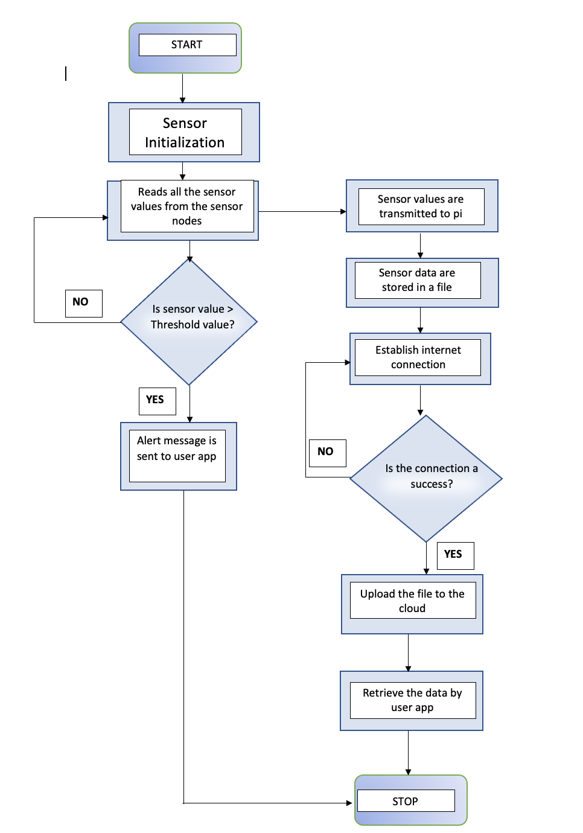
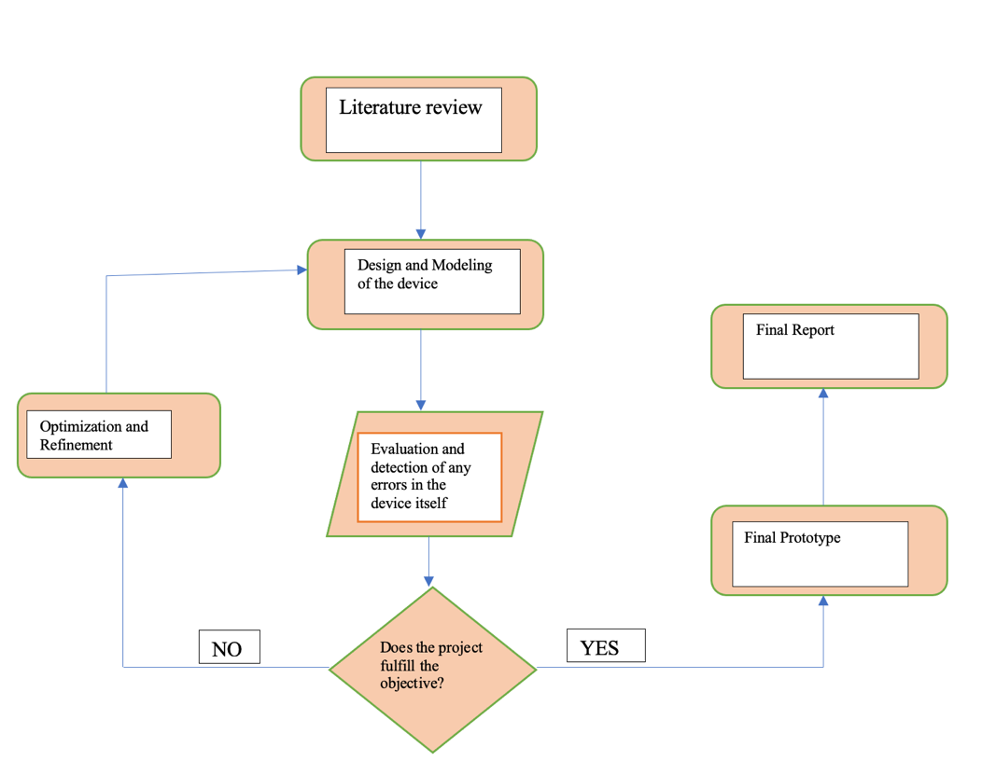
I.FLOWCHART OF THE PROJECT
II.FLOWCHART OF THE RESEARCH ACITIVITY

Slide 13
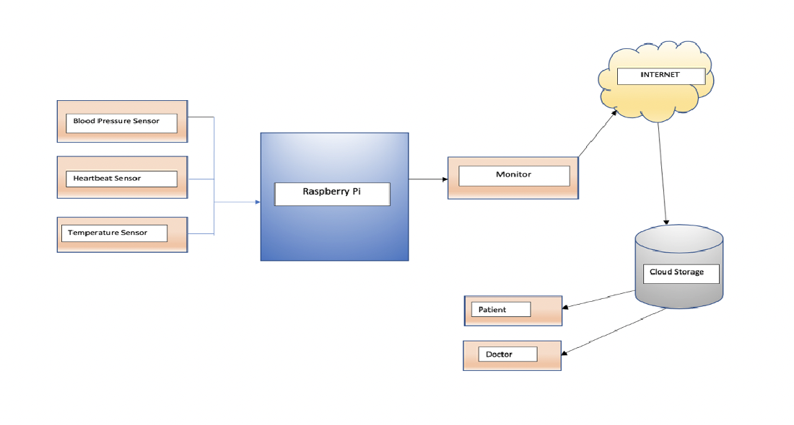
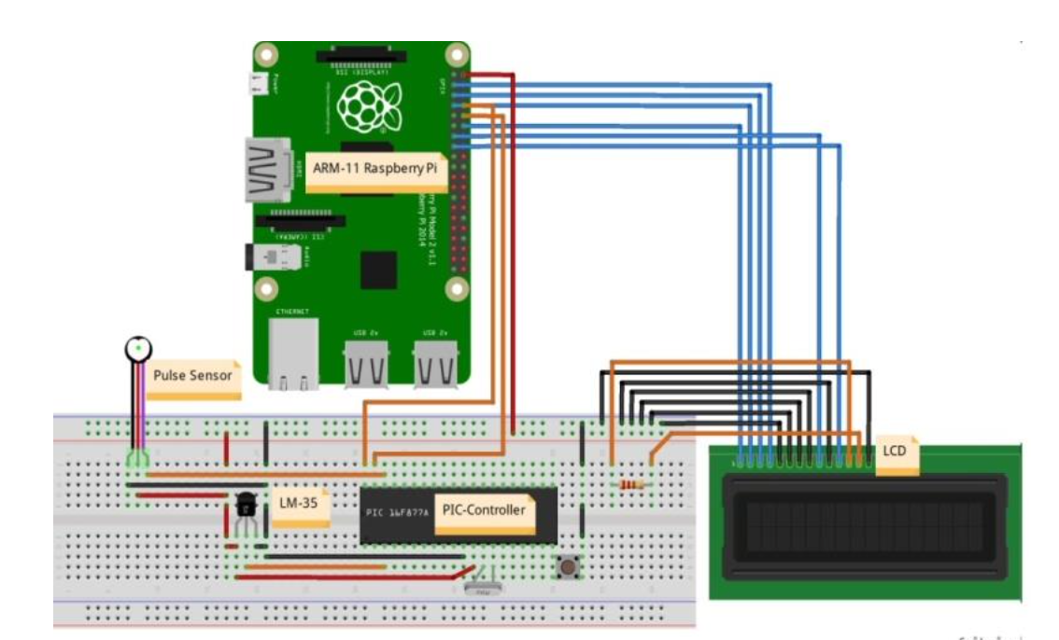
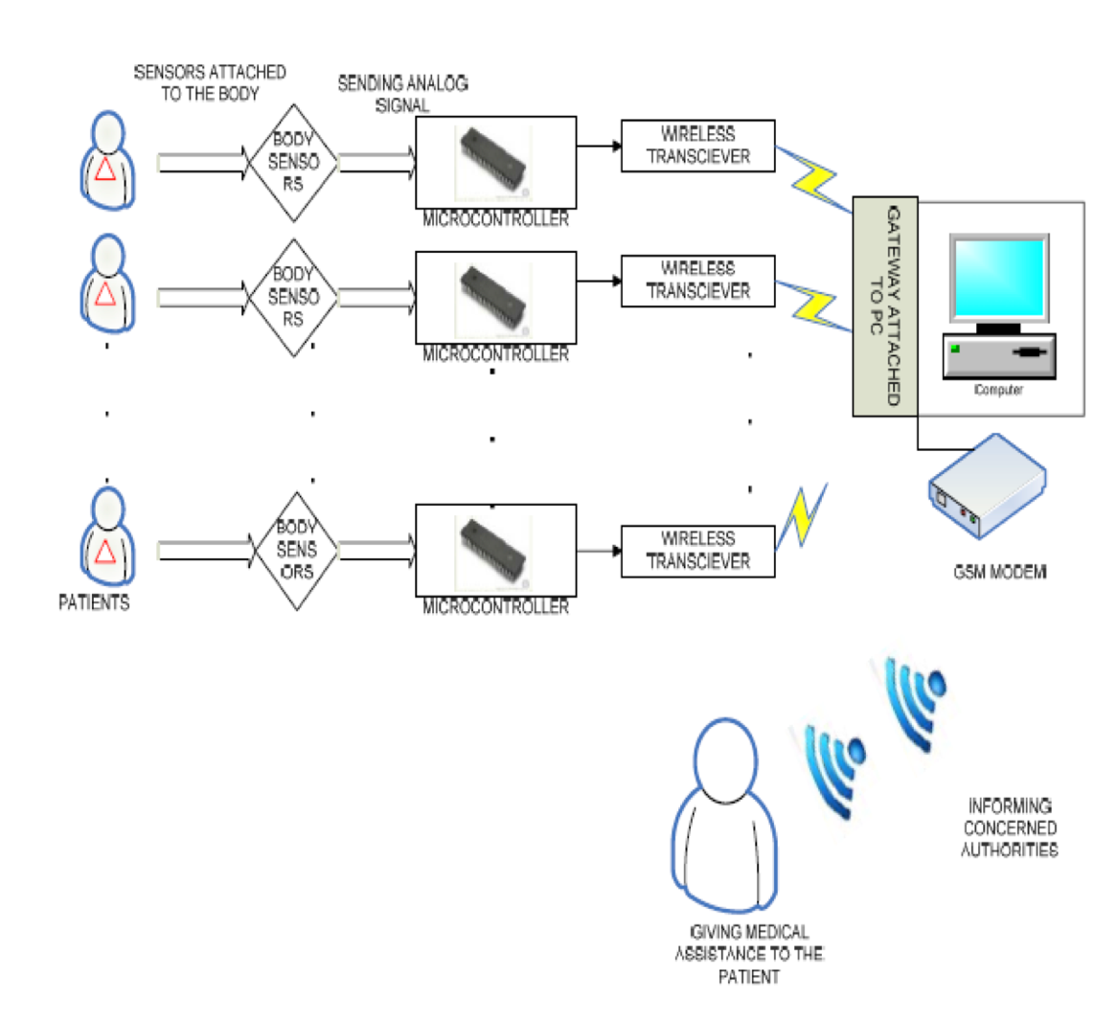
A.BLOCK DIAGRAM
B.CIRCUIT DIAGRAM
C.CLOUD COMPUTING

Slide 14
PRELIMINARY DATA
NUM | HARDWARE COMPONENTS | QUANTITY | PRICE
1. | Raspberry Pi 3 Model B+ | 1 | 220.00
2. | Jumper Cables | 1 | 2.00
3. | Lm358 Heart beat Sensor | 1 | 17.00
4. | LCD Display | 4 | 10.00
5. | Lm35 Temperature Sensor | 1 | 17.00
6. | ECG sensor | 1 | 42.00
7. | Breadboard | 1
8. | SIM 800l GPRS GSM module | 1
9. | MCP 320 | 1
TOTAL |  |  | 79.30

Slide 15
DISCUSSION
The main motive of this proposed system is to establish a smart health device depending on the robust IoT tools, with the help of a microcontroller known as the Raspberry Pi Model B+.
The sensor nodes on the patient's side are to monitor the patient's symptoms.
Blood pressure, heart beat, temperature and blood oxygen are the used sensors.
The data is collected by these sensors and sent to a server.
The server will then process the acquired monitor data and make it available to other users, such as the cloud, doctors, and caregivers, in order to detect and monitor health issues.

Slide 16
CONCLUSION
In the FYP 1, there is more research on the theory part where all the cost of the hardware components are covered.
The proposed smart health monitoring components is briefly studied. This summarizes how the raspberry pi works in connecting the sensor with database.
Likewise going in depths with the FYP1 Project and learning about the basics of the hardware and software tool.
Eventually, after the completion of the FYP1 report we move forward to the FYP 2 where we assemble all the hardware components utilizing the software tool.
This framework of the FYP1 report helps us develop the prototype of this report we are working on. The cost has already been separated for the development of the prototype.

Slide 17
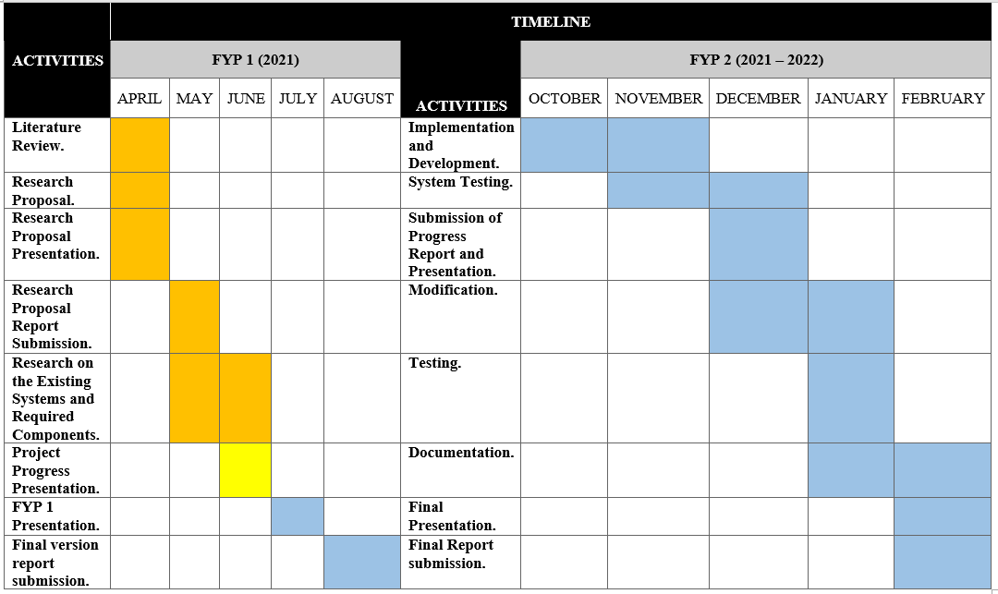
GANTT CHART

